Slide 1

Zowe Community 20PI3 Squad Focus

Slide 2
Notes
Before this presentation ZLC will present Zowe achievements from last PI and context/vision at a hill-level for the upcoming PI
Following this presentation, the squads will disperse into breakouts to plan their PI in more detail

Slide 3
Agenda
API ML Squad Focus
App Framework Squad Focus
CLI Squad Focus
Zowe Explorer Squad Focus
Onboarding Squad Focus
Systems Squad Focus
“Deployments” Working Group Focus
Doc Squad Focus

Slide 4
API ML Squad Focus
Elliot Jalley (Squad Lead)

Slide 5
Dependencies
Systems Squad – ‘Design Zowe HA Infrastructure’

Slide 6
Feature 1
x.509 client certificate authentication support for API Mediation Layer
(in support of SECURITY theme)
As a system admin / security admin, I want to allow Zowe users and client applications (such as Zowe clients and custom applications) to authenticate with Zowe API ML using client certificates (x.509) which are industry-proven as more secure than credential authentication.
Deliverable: Zowe API ML can validate client certificates by using ESM to map the certificate with the user mainframe identity and issue a JWT.
Notes:
Notes:
x.509 is one of the industry standard ways of authenticating to backend services
Zowe Client apps will need to be updated to support client certs
Customer apps may have their own way of supporting client certs

Slide 7
Feature 2
Remove the dependency of APIML on z/OSMF for authentication and use SAF to obtain the JWT
(in support of SECURITY theme)
As a system admin / security admin, I want a configurable option at installation of Zowe to use SAF as my authentication provider, thereby eliminating the pre-requisite on z/OSMF, and removing a barrier to my adoption.
Deliverable: Instead of a call to z/OSMF, Zowe API ML will use SAF APIs to verify credentials. This will be implemented as an additional provider, the z/OSMF authentication provider will remain the default.
Notes:
Zowe APIML currently depends on z/OSMF to be installed in the same security domain for authentication.
There are use cases where just APIML is needed on some systems and there is z/OSMF on other systems or any system in the same security domain.
This is a request to:
Remove the dependency of APIML on z/OSMF for authentication and use SAF to obtain the JWT
This will be implemented as a different provider, the z/OSMF authentication provider will remain the default
z/OSMF will not be accessible via API ML if z/OSMF will not trust SAF JWT
Update the installation process to allow this option

Slide 8
Feature 3
Support for high availability / sysplex distributor in API Mediation Layer
(in support of RESILIENCE theme)
As an API consumer, I’m able to rely on API routing by Zowe API ML with an expectation of 24/7 SLA.
Deliverable: The usage of Dynamic Virtual IP Address (DVIPA) will ensure that if an instance of Gateway and/or Discovery fails on one system (LPAR1), the other system (LPAR2) continues to provide service functionality through a sysplex distributor.
Dependency: Systems Squad – ‘Design Zowe HA Infrastructure’
Notes:
Config, Doc, testing for CICD squad.

Slide 9
App Framework Squad Focus
Sean Grady (Squad Lead)

Slide 10
Dependencies
Cross Squad Dependencies 1
Cross Squad Dependencies 2

Slide 11
Features
Feature xxxx (in support of theme xxx)

Slide 12
CLI Squad Focus
Mike Bauer (Squad Lead)

Slide 13
Feature 1
Zowe consumers can begin building apps and/or custom automation within hours by readily finding and leveraging Zowe SDKs, API documentation, and samples Deliverables: Documentation is published on our Zowe Docs site covering the overview and use of the SDKs as well as documenting how the community can contribute to the technology. In addition, detailed samples that leverage the SDKs are provided within each repository. To further drive visibility and adoption, the Zowe Node SDK packages are published to public npm separate from the Zowe CLI.

Slide 14
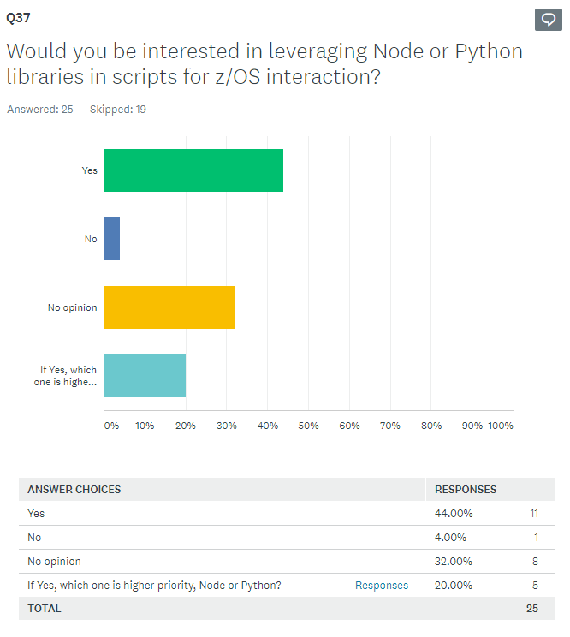
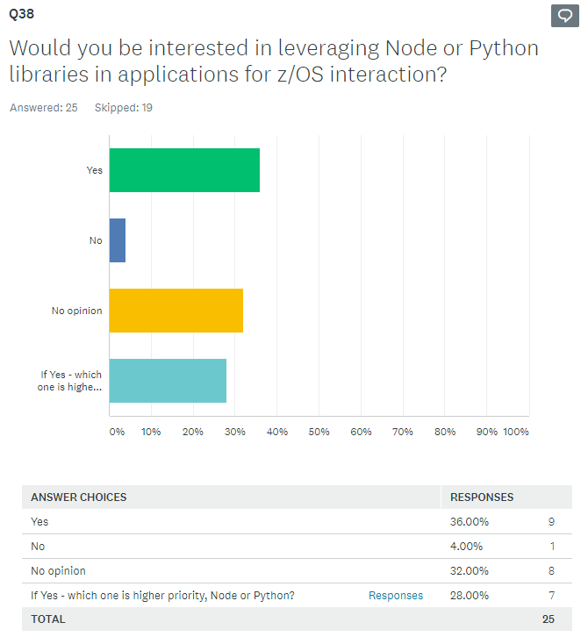
Community Feedback

Slide 15
Feature 2
Zowe CLI users can store all connection details and command option preferences in a single profile allowing for quick initial configuration and reduced effort when updating properties.
Deliverable: Simplified profile management by allowing all profile options to be specified in a single base profile. This is an enhancement to the core CLI.

Slide 16
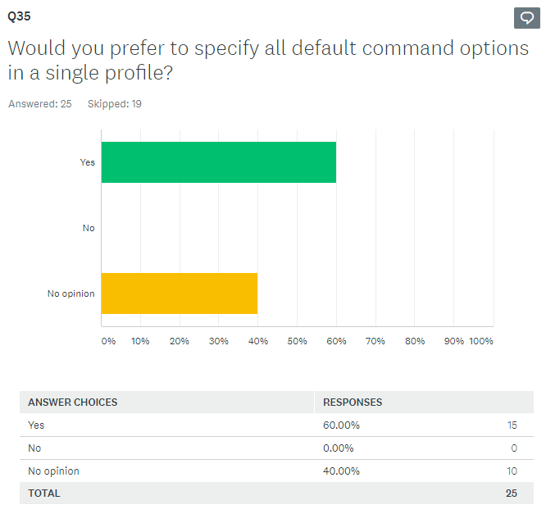
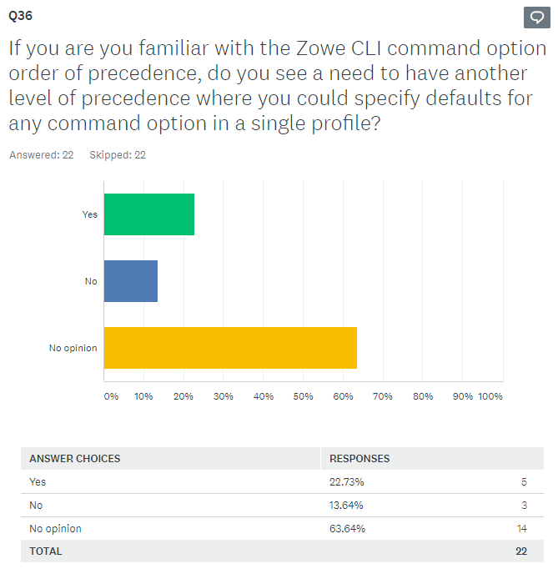
Community Feedback

Slide 17
Zowe Explorer Squad Focus
Fernando Rijo Cedeno (Squad Lead)

Slide 18
Dependencies
Cross Squad Dependencies 1
Cross Squad Dependencies 2

Slide 19
Features
Define and develop a set of conformance guidelines to be consumed by extenders of the Zowe Explorer. #837
To deliver standardized guidelines that Extenders of the Zowe Explorer can follow in order to leverage and grow the Zowe ecosystem
Leverage the Zowe CLI security enhancements around MFA and SSO for an improved security experience in the Zowe Explorer.
To increase user confidence knowing that the extension implements best security practices in order to remain compliant with corporate policies.

Slide 20
Features
Enhance the profile management user experience of Zowe Explorer (for new and regular users) (Epic) (Issues)
To deliver a greater experience when configuring and managing connection details by addressing community related issues around profiles.
Enhance the z/OS Unix user experience of Zowe Explorer (Epic) (Issues)
To deliver a greater experience when working with z/OS Unix by addressing community related issues.
Enhance the Dataset manipulation user experience of the Zowe Explorer
To deliver a customized experience for creating datasets so that users can specify desired allocation details.

Slide 21
Onboarding Squad Focus
Rose?? Joe W? (Squad Lead??)

Slide 22
Dependencies
Cross Squad Dependencies 1
Cross Squad Dependencies 2

Slide 23
Focus
Further Conformance Process Maturity
Active LTS conformance test criteria updates / incremental badging / app-store-like landscape page
Active LTS conformance change requests (test criteria & submitter form)
Increase focus on Outreach
Webinars & Marketing
Improve Onboarding experience
Improve/influence Zowe.org website navigation
Accurately “direct” new-to-Zowe visitors
Continue and transition stat reporting (KPI-centric)
Identify trends & influencers
Easy prep for all Zowe Communications
Notes:
Leverage new UX members / design thinking / persona identification Onboarding New Members

Slide 24
Systems Squad Focus
Mark Ackert (Squad Lead)
f.k.a. CI/CD Squad

Slide 25
Dependencies
Other squads may use the performance test framework to design and run their own test cases. (This doesn’t affect our PI3 deliverables.)
Work closely with APIML/Web UI squads related to High Availability / SYSPLEX.

Slide 26
Focus
Expand system testing in the community
Component integration testing on Marist systems
Zowe “release” smoke and integration testing
Build out Zowe “release” Performance Testing
Standardize infrastructure and tooling, extensible code-base for squad contribution
Continue Zowe Release activities and improvements
Second Nightly “Stable” Build
Design Zowe HA Infrastructure

Slide 27
Performance Test – scenario I
As Zowe contributors, we want to know release to release performance changes.
Deliverable:
Provide release to release comparison report.
The report should be able to provide common performance metrics including CPU, memory and I/O rates, paging rates on server side and API requests per seconds, error rates, etc.
Drive continuous testing on performance in consistent / repeatable / automated fashion.
Provide a simple way to define performance test cases which should be portable and extendible. Developers can easily customize the existing test cases, creating new and run them on any z/OS systems.
Notes:
To gather reliable test result, ideally we need dedicated hardware to run the performance test.

Slide 28
Performance Test – scenario II
As a z/OS system programmer, I would like to be able to estimate the cost of running Zowe, and fine tune my Zowe performance based on my estimated workload.
Estimated workload at first refers to concurrent user count.
Deliverable:
Deliver a tool users can run to provide them with a performance and cost estimation report.
Provide a way to aggregate accurate z/OS resource for Zowe usage from SMF 30 record.

Slide 29
High Availability / Resilience
As a z/OS system programmer I can configure Zowe z/OS Components to deliver its services through a Highly Available endpoint, using familiar practices and technology.
As a z/OS system programmer I an able to use familiar console automation offering to run, configure, and monitor Zowe z/OS components.
Deliverable:
Provide configuration guidance (including pre-req changes) to achieve HA / load balancing with APIML or SYSPLEX Distributor.
Investigation routes:
HA / Load balancing via APIML
HA / Load balancing via SYSPLEX Distributor
Notes:
Notes:
We have identified many investigation / research items to support HA, we may only achieve part of the deliverables.
To support SYSPLEX test, will need to find resource either from Marist or internal. The systems in SYSPLEX should be real LPAR to get the accurate measurement.

Slide 30
“Deployments” Working Group Focus
Steven Horsman, Joe Winchester, Sean Grady contributing
f.k.a. CUPIDs

Slide 31
Focus
Design and Begin Deployment, Packaging and Management Hill [Steve, Joe]
Improve both Zowe administrator and Zowe extender user experiences when developing and deploying Zowe extensions by streamlining packaging, install, upgrade, and configuration.
Unify existing Zowe core components and extensions with the new extension design and rebuild documentation
Scope of changes dependent on available resource and design validation
This may shift into v2 if breaking changes are required
Research and POC containerization of Zowe. [Sean]
Initially targeted for developers

Slide 32
Dependencies
Cross squad:
If we get around to the de-coupling of the existing zowe core components, then some assistance in migrating current install scripts out of zowe-install-packaging maybe be required
Other dependencies:
Access to extender and installers to validate the design
Sample spring boot rest api and sample node api to extend/use as the base for the packaging and deployment samples

Slide 33
Doc Squad Focus
Ashley Li (Squad Lead)

Slide 34
Dependencies
All squads – New feature content
Onboarding squad – Collaborate on zowe.org design and better navigation

Slide 35
Focus
Create and publish content for different Zowe components.
Allow users to browse doc by area of interest, user role, and skill level.
Provide better contribution doc about contributing to doc and code.
Improve release notes by automating its generation from CHANGELOGs and providing better business value.
Contribute to the Zowe.org website design enhancement.
Provide and consolidate more multi-media and visual content (videos, interactive graphics, diagrams).
Identify content gaps and improvement areas by leveraging content analytics.

